Slide 1
18-799: Applied Computer Vision Spring 2026
Course Logistics

Slide 2
Objectives
In today’s class we will learn
General Motivation
Course Logistics

Slide 3
Course Information
Instructors
Moise Busogi
Assane Gueye
Teaching Assistants:
Miracle James (Office Hours: TBD)
Joel Adebayo (Office Hours: TBD)
Eleanor Wepngong (Office Hours: TBD)

Slide 4
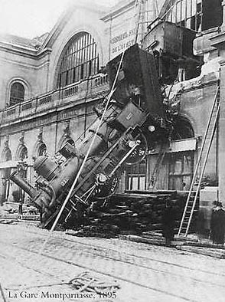
Every picture tells a story
Goal of computer vision is to write computer programs that can interpret images
Slide by Szeliski, Richard

Slide 5

Every picture tells a story
https://nypost.com/2018/06/26/exhausted-doctors-are-putting-patients-in-danger/

Slide 6

Every picture tells a story

Slide 7

Every picture tells a story
Perspective versus truth
https://share.google/images/y1DP9uB2tdqaI2nP2

Slide 8
Optical Illusion

Slide 9
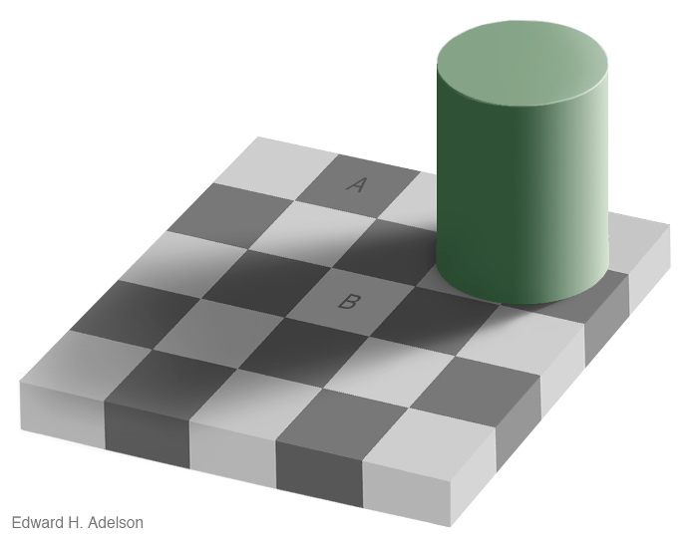
Optical Illusion

Slide 10
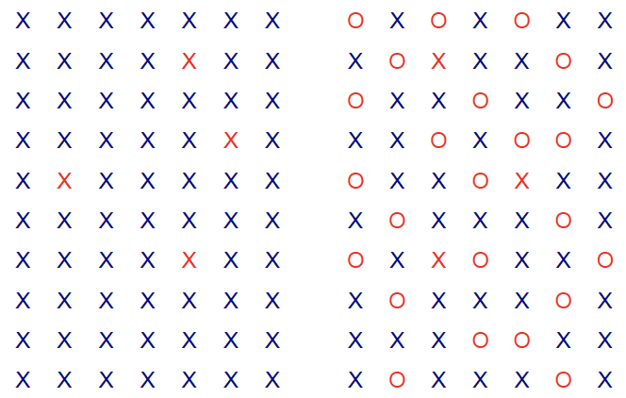
Optical Illusion

Slide 11


Optical Illusion

Slide 12
Computer Vision
In computer vision, we are describing the world that we see in one or more images
Reconstruct its properties, such as shape, illumination, and color distributions.

Slide 13
What is computer Vision
Computer Vision studies how machines acquire, process, and interpret visual information from images and videos.
It combines geometry, physics, statistics, and machine learning to extract meaning from visual data.
pixels → representations → decisions
Slide by Szeliski, Richard

Slide 14

CV Applications
Optical character recognition (OCR),http://yann.lecun.com/exdb/lenet

Slide 15
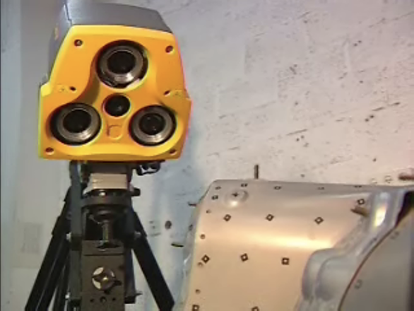
CV Applications
Mechanical inspection, http://www.cognitens.com;

Slide 16
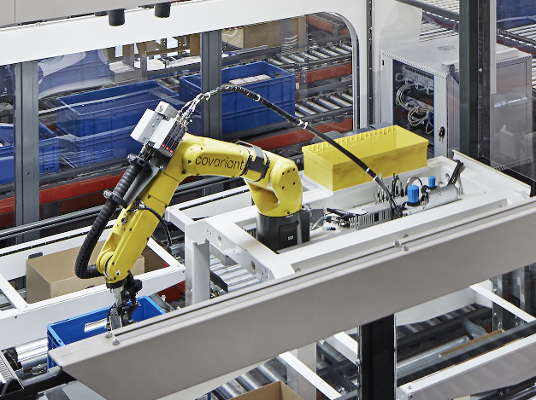
CV Applications
Warehouse picking,https://covariant.ai

Slide 17
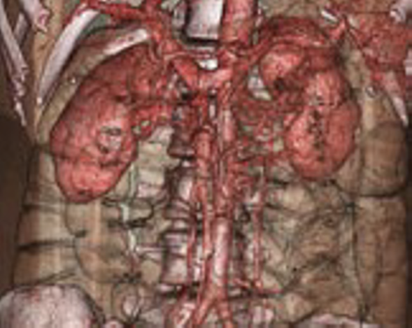
CV Applications
Medical imaging, http://www.clarontech.com

Slide 18
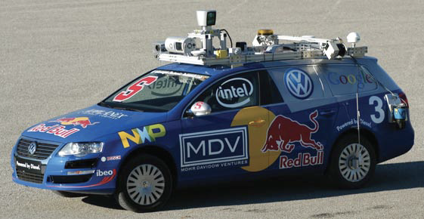
CV Applications
Self-driving cars, (Montemerlo, Becker et al. 2008) © 2008 Wiley

Slide 19
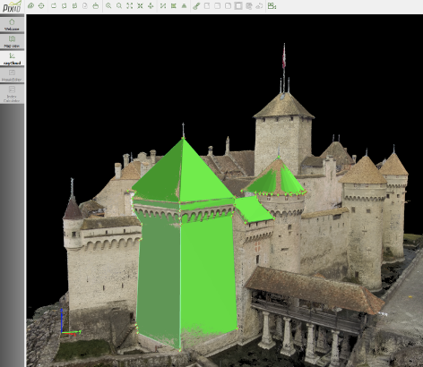
CV Applications
Drone-based photogrammetry, https://www.pix4d.com/blog/
mapping-chillon-castle-with-drone.

Slide 20
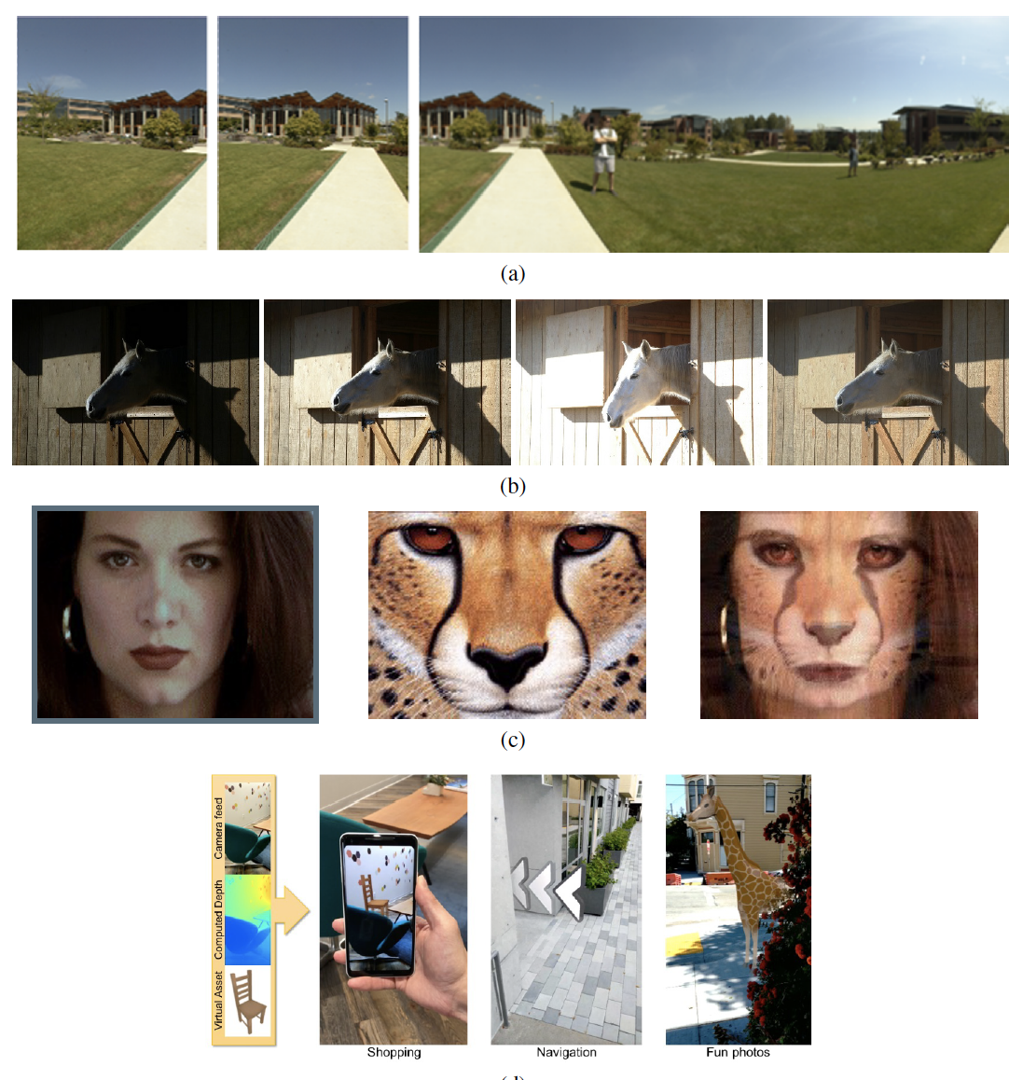
CV Applications
Some consumer applications of computer vision:
(a) image stitching: merging different views (Szeliski and Shum 1997) © 1997 ACM;
(b) exposure bracketing: merging different exposures;
(c) morphing: blending between two photographs (Gomes, Darsa et al. 1999) © 1999 Morgan Kaufmann;
(d) smartphone augmented reality showing real-time depth occlusion effects (Valentin, Kowdle et al. 2018) © 2018 ACM

Slide 21
Learning Outcomes
By the end of the course, students will be able to:
Explain and apply camera models and geometric principles underlying image formation.
Use digital image processing techniques to extract meaningful visual information.
Implement feature-based and classical machine learning methods for visual recognition tasks.
Train and analyze deep learning models, including convolutional and transformer-based architectures, for vision applications.
Construct and interpret 3D vision pipelines for spatial understanding and reconstruction.

Slide 22
Class Policies
You are expected to attend every class; if you need to miss a lecture because of a medical emergency or something equally significant, please let the instructor know by email before the lecture (if applicable).
There will be no make-up quizzes or exams.

Slide 23
Homework Policies
Students are encouraged to discuss homework problems with classmates, teaching assistants, and the instructor.
Such collaboration must be limited to clarifying the problem and discussing high-level solution strategies.
All submitted work must be produced independently by the student and written in their own words. Solutions may not be copied from any person, online source, or prior coursework.
Copying another student’s homework or exam, or allowing one’s own work to be copied, constitutes academic dishonesty and will be treated as cheating.
If there is any uncertainty about whether a particular activity or form of assistance is permitted, students are expected to consult the instructor in advance.
Each student is granted a total of three slack days for the term, with no more than one slack day allowed per assignment. Slack days must be used explicitly and are intended for unforeseen circumstances.
Homework assignments must be submitted by the stated deadlines. Late submissions will not be accepted except through the use of approved slack days.

Slide 24
Project Policy
As part of exploring real-world applications of computer vision, the course requires a semester-long project.
Projects must go beyond theory and address a practical, real-world problem.
Students will work in teams of four.
Choose a project that sparks your curiosity and aligns with your interests and passions.

Slide 25
Project Policy
Problem Selection Choose a meaningful, real-world problem that motivates your project.
Teamwork Work in teams of four. Collaborate effectively, leverage diverse strengths, and communicate clearly.
Project Execution Research existing approaches, explore datasets, and design a solution with a clear end goal.
Demonstration Every project must include a live or recorded demo. A project is not complete without showing it in action.
Peer Review Projects will be reviewed by classmates. Be open to feedback and use it to improve your work.
Novelty & Deployment Novelty and Physical or system-level deployment are strongly encouraged (e.g., cameras, embedded devices, robots, sensors, actuators).
Grading Evaluation is based on a combination of peer reviews and instructor assessment, with emphasis on originality, execution, and demonstration quality.

Slide 26
Recitation & Labs
There will be at least one-hour recitation/lab every week
Recitation/lab attendance is not mandatory, but is extremely valuable

Slide 27
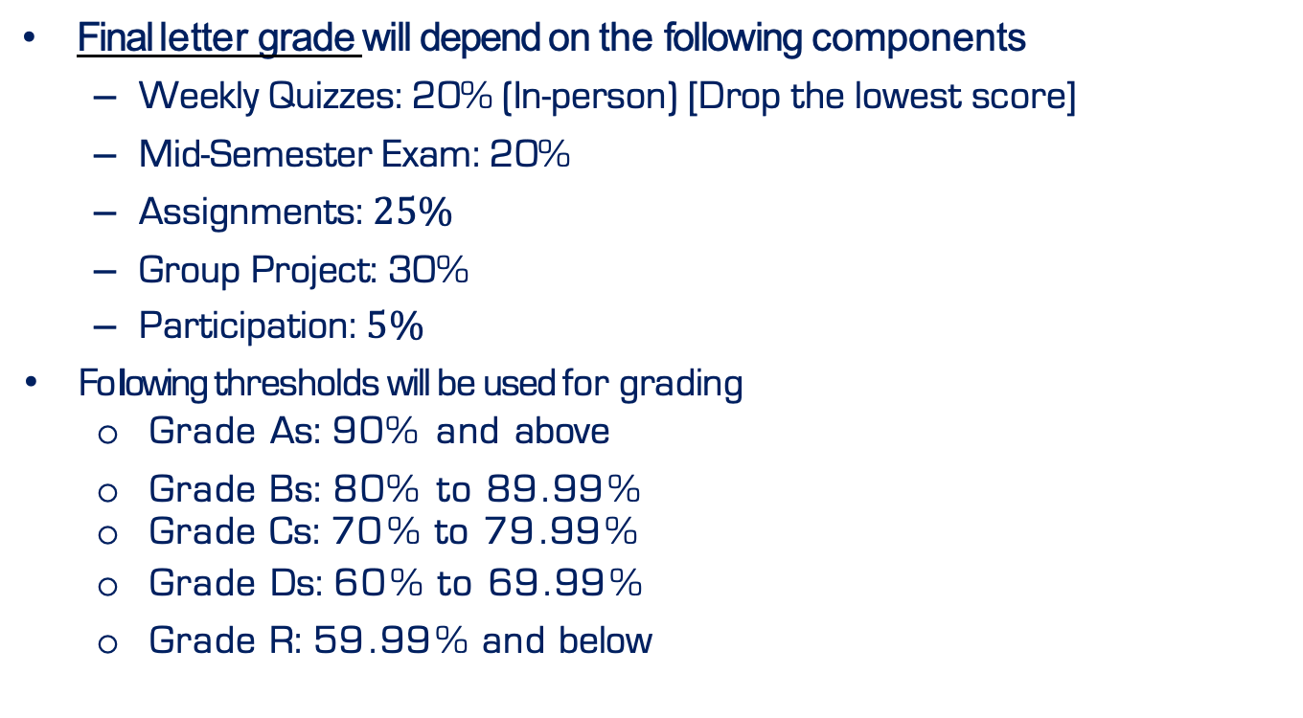
Grading Policy
Final letter grade will depend on the following components
Weekly Quizzes: 20% (In-person) [Drop the lowest score]
Mid-Semester Exam: 20%
Assignments: $25\%$
Group Project: 30%
Participation: $5\%$
Fo lowing thresholds will be used for grading
Grade As: 90% and above
Grade Bs: 80% to 89 . 99 %
Grade Cs: 70 % to 79 . 99 %
Grade Ds: 60 % to 69 . 99 %
Grade R: 59 . 99 % and below

Slide 28
Take care of yourself
Do your best to maintain a healthy lifestyle this semester
by eating well,
exercising,
avoiding drugs and alcohol,
getting enough sleep and
taking some time to relax.
This will help you achieve your goals and cope with stress.
All of us benefit from support during times of struggle. You are not alone.
There are many helpful resources available on campus and an important part of
The college experience is learning how to ask for help.
Asking for support sooner rather than later is often helpful. call 0788503528 (Solid Minds) and visit CaPS website at http://www.cmu.edu/counseling/.
Consider reaching out to a friend, faculty or family member you trust for help

